Slide 1

Face Recognition System
Group - 05
Mir Fahad Abdullah | 2121572642
Sairat Jamin Shefa | 2122172042
Md. Raduain Hossain Rimon | 2021995642
Fatema Rahman Lamia | 2021996642

Slide 2

Introduction
Human emotions are an important part of communication, helping us express thoughts and feelings without words. Recognizing emotions automatically can bring new possibilities in healthcare, education, and human-computer interaction. For example, virtual assistants can respond better, and teachers can track student engagement. As the need for intelligent systems that adapt to human emotions grows, this project focuses on using machine learning to address this challenge in a simple yet effective way.

Slide 3

motivation
Emotion recognition helps improve communication and
makes interactions more thoughtful.
Machine learning can pick up small emotional clues,
making the system more accurate and reducing mistakes.
Applications in healthcare, education, and everyday
technology make life more accessible and user-friendly.

Slide 4

Project objective & scope
OBJECTIVE:
The main objective of our project is to accurately identify emotions through facial expressions.
Build a system that classifies emotions in real-time to improve interactions and user experience.
Ensure the solution is efficient and adaptable to various applications.
SCOPE:
Understand emotions and their facial expressions for training the recognition model.
Develop a simple, user-friendly system for use in healthcare, education, and other fields.
Explore future improvements for real-time emotion detection.
The main aim of our project is to detect skin disease effectively and efficiently

Slide 5

Tools & Resources
Python (Language)
scikit-learn (Machine learning library)
scikit-image (Library)
Matplotlib (Visualization Library)
OpenCV (Image processing Library)
Jupyter Notebook (Platform)
Emotion Dataset (Image Dataset)

Slide 6
Process of work
Data Collection
Data Preprocessing
Model Development
Model Training
Testing and Validation
Model Evaluation
Documentation

Slide 7

Project dataset
Collected a dataset containing:
Facial images of 10 individuals.
8 classes of different expressions.
Angry
Contempt
Disgust
Fear
Happy
Neutral
Sad
Surprised
80 images of different facial expressions.

Slide 8
Feature Extraction
Histogram of Oriented Gradients (HOG)
HOG Parameters:
orientations=9, # Number of gradient bins= 9
pixels_per_cell=(8, 8), # Size of each cell in pixels= 8x8
cells_per_block=(2, 2), # Number of cells per block
block_norm='L2-Hys', # Histogram Clipping normalization method
transform_sqrt=False, # No image square root transformations
feature_vector=True, # Return the histogram
visualize=False # Do not return the visualization
HOG descriptor will return a 1D feature vector which is
Known as Histogram.

Slide 9

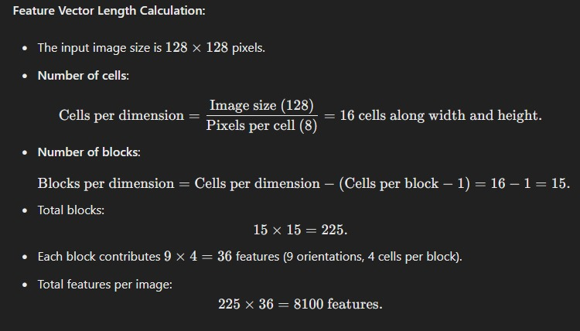
Feature Extraction

Slide 10
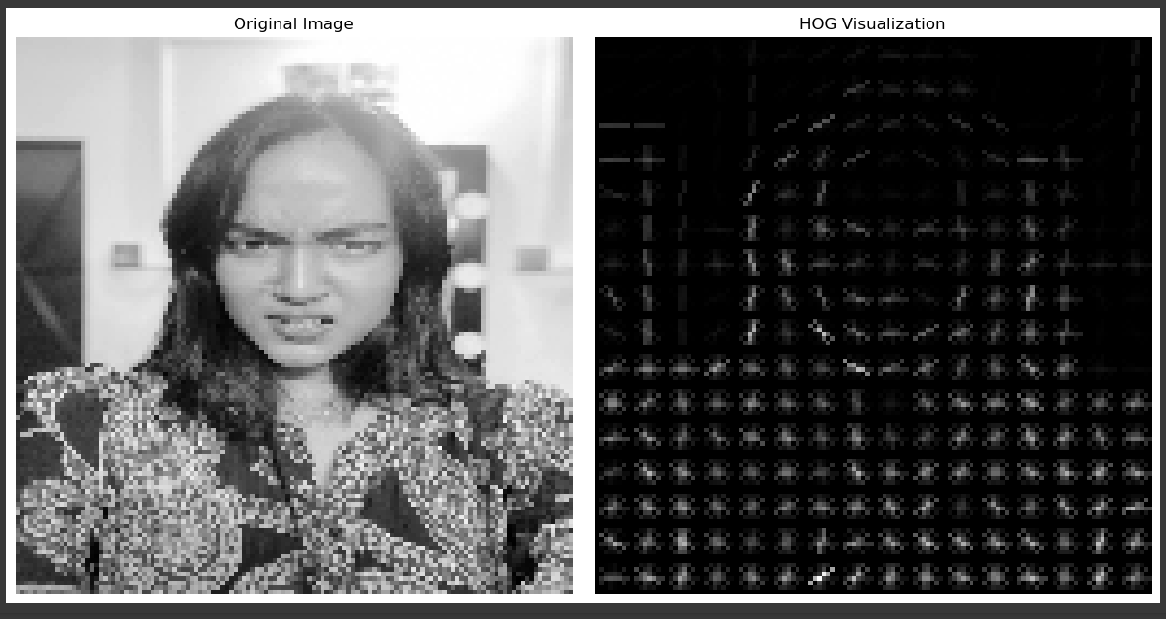
Hog transformation

Slide 11
Data Preprocessing
HOG feature Extraction
LabelEncoder to encode the categorical data labels
Feature Scaling the extracted HOG feature matrix
Dimension reduction using
PCA(Principal Component Analysis)
Splitting the Dataset into training and test set.
70% data for training and 30% data for testing

Slide 12
Support Vector Classifier
- SVC model

Slide 13
Support Vector Classifier
SVC model parameters:
kernel='rbf’ //Radial Basis Function kernel
gamma='scale’;
C=1 //The regularization parameter
class_weight='balanced’
(To handle imbalanced situation in Datasets)

Slide 14
regularization parameter tuning (C)
C=0.1 ➔ Test accuracy: 68.50%
C=1 ➔ Test accuracy: 91.67%
C=100 ➔Test accuracy: 75.15%
So,
Small regularization, allowing some misclassifications to prevent overfitting.
Large regularization, aiming for a perfect fit on the training data, which may overfit.

Slide 15
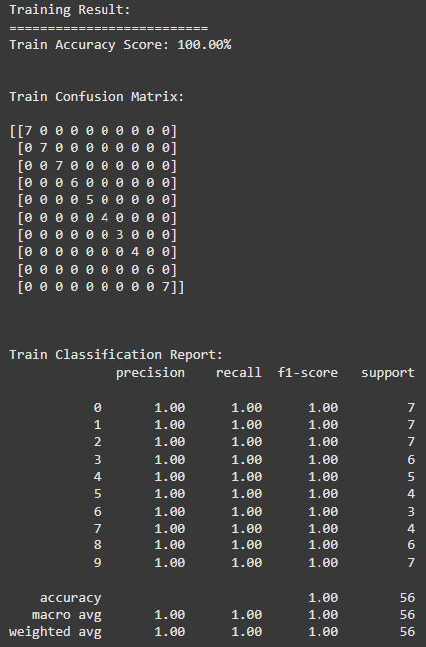
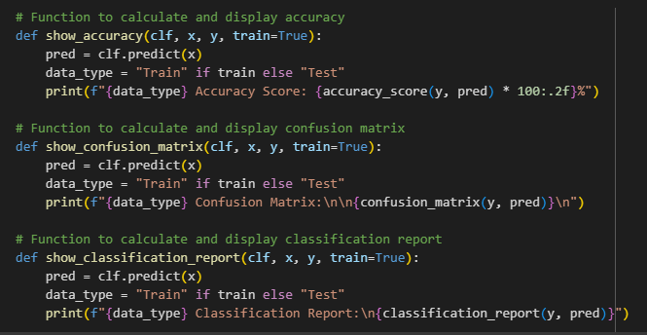
Model evaluation

Slide 16
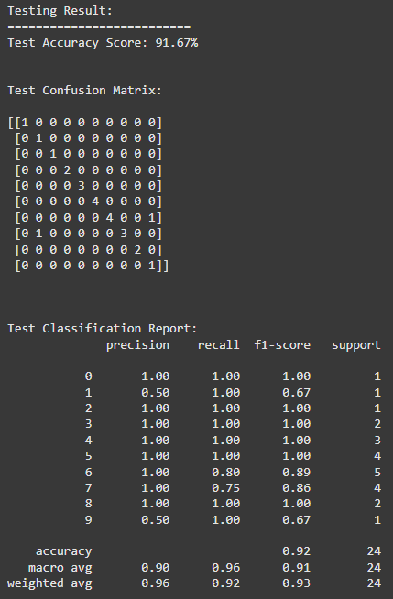
Model evaluation

Slide 17
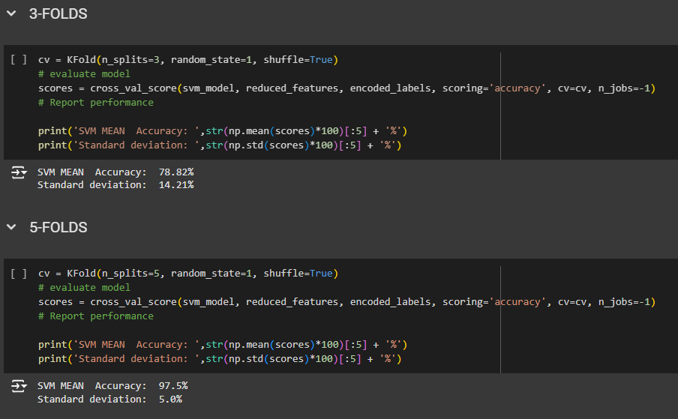
Cross-validation accuracy

Slide 18
Result and discussion
Result:
Training data with 100% of accuracy
Testing data with 91.67%. of accuracy
In cross validation accuracy for 3-FOLDS,
- Mean Accuracy: 78.82%
- Standard Deviation: 14.21%
For 5-FOLDS
- Mean Accuracy: 97.5%
- Standard Deviation: 5.0%.
Discussion:
HOG feature representation is strong.
PCA could reduce dimensions without losing important information.
SVM did relatively well on this small data set.
Poor size of dataset impacts generalization.

Slide 19

AI across various applications.
Conclusion
In conclusion, this project offers an adaptable, accurate approach to emotion recognition, addressing dataset limitations and enabling improved human-computer interaction, user experiences, and empathetic AI across various applications.

Slide 20

Thank You!

